Slide 1
Write the expression
A number added to 7 | a+7
A number is multiplied by nine | 9g
8 is taken from a number | d-8
A number is shared between 3 | T ÷ 3
Notes:
hook

Slide 2
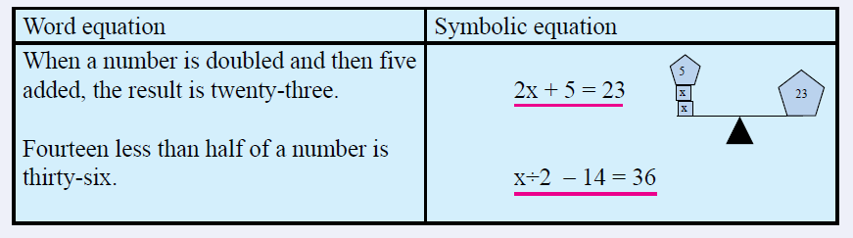
24
7
30
Date
Algebra
EQ – how do we solve algebraic equations?
5
Notes:
Lesson objective (EQ)

Slide 3
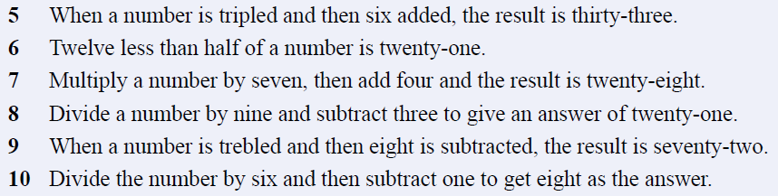
Try these

Slide 4
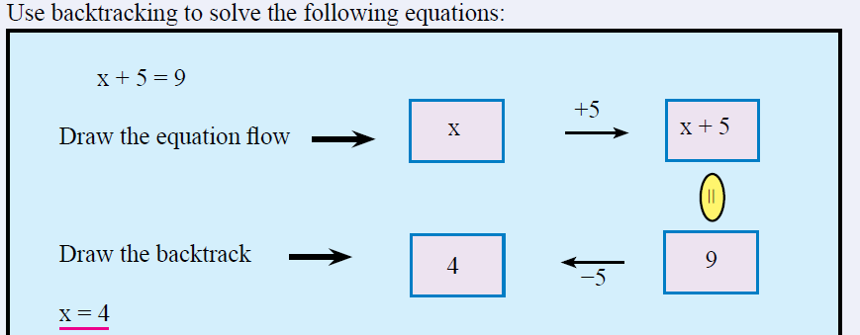
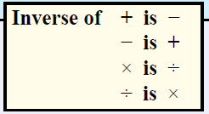
24
7
30
Date
Algebra
EQ – how do we solve algebraic equations?
5
Notes:
Lesson objective (EQ)

Slide 5
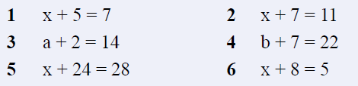
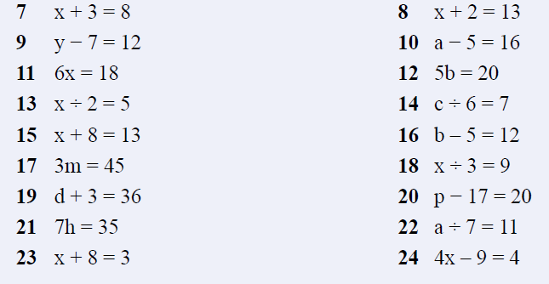
Padawan
Jedi knight

Slide 6
Quickwrite
How do you solve algebraic equations?
What are the steps?
How do we know we are correct?
Notes:
Closure

